Slide 1
Customer Review on LS Fitting for ISIS
Anders Markvardsen
ISIS, Sep, 2017

Slide 2
Menu for today
Why and global vs local fitting
Local fitting/optimisation
Global fitting/optimisation

Slide 3
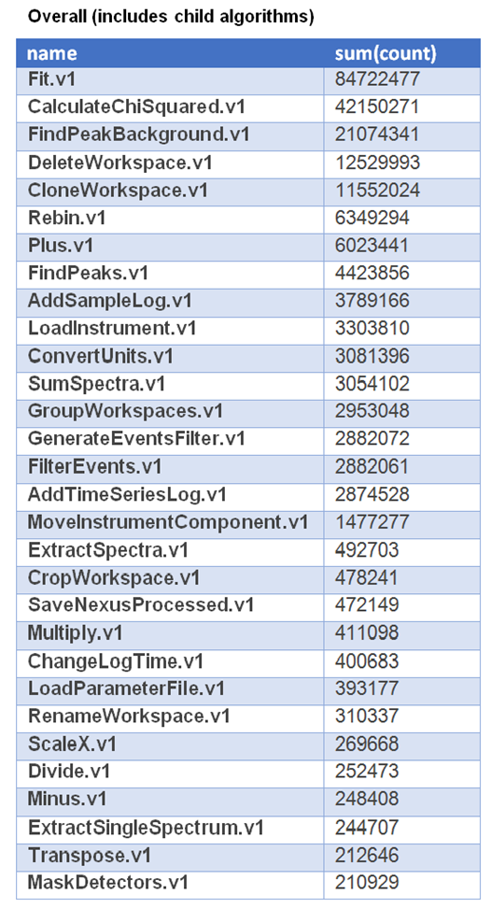

Why?
Mantid:
Other software include: GSAS/Fullprof/DASH etc…

Slide 4
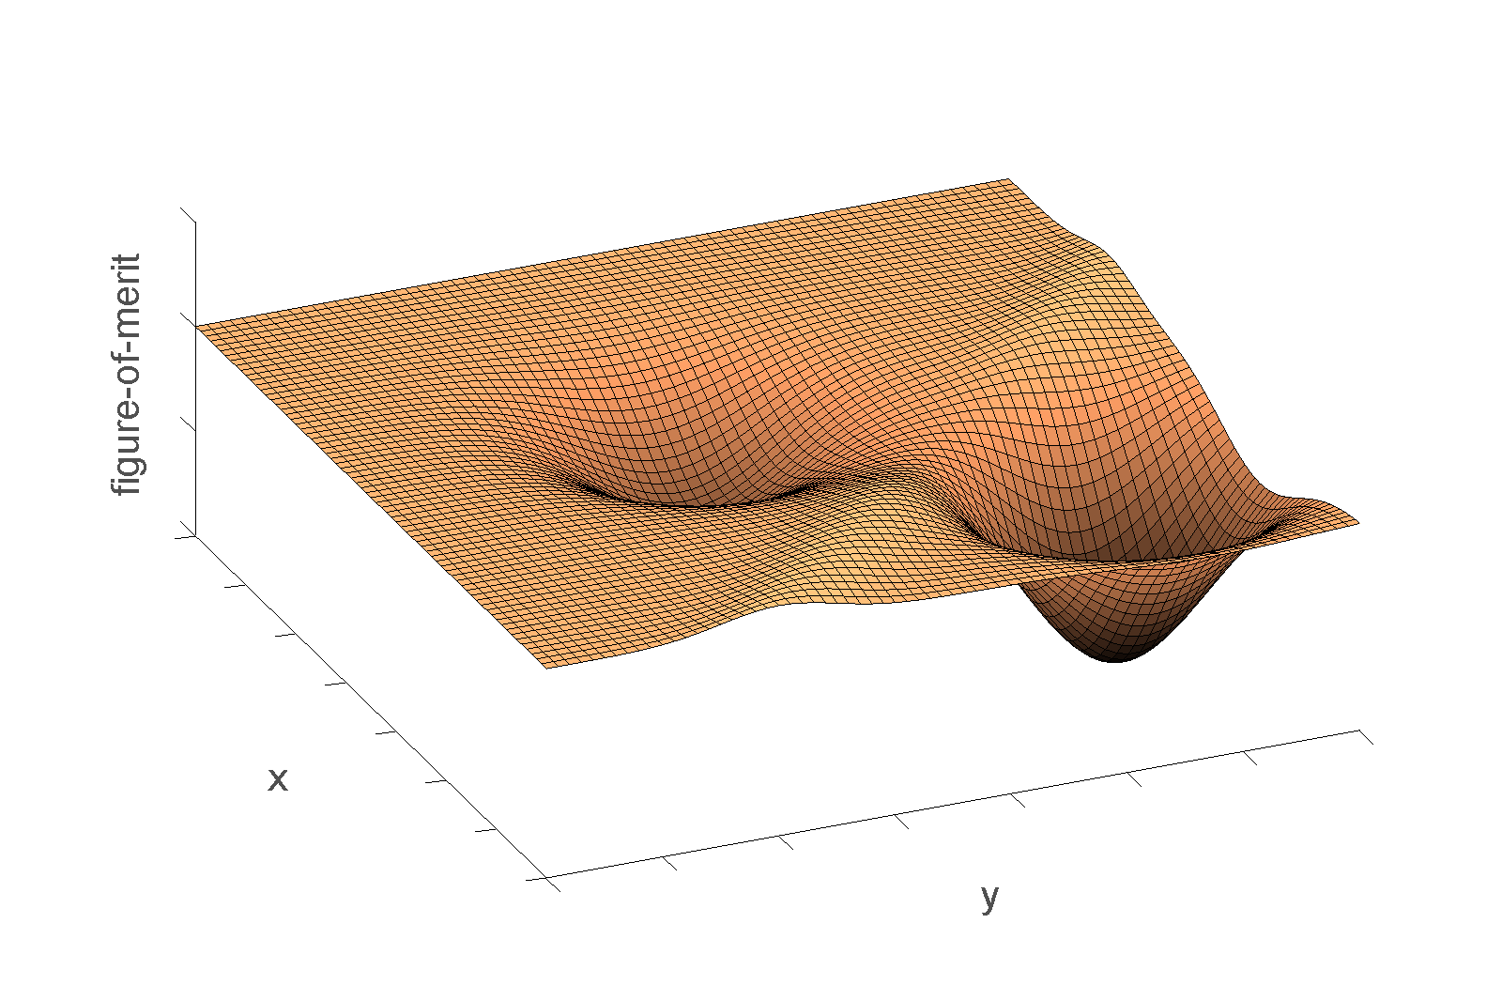
What is global optimisation?

Slide 6
Local fitting
Have an idea of what the answer should be
Example: All Rietveld codes and currently 99% what Mantid does
Global fitting
Have no (or little) idea what the answer should be
Example: Global structure determination, e.g. DASH

Slide 7
Local fitting
Mantid fitting engine is like a car from the 60s
using generic minimizers from GSL
any improvements (speed and/or accuracy) at least a proportional benefit across the science areas Mantid support
~10% one FTE Mantid and ~0.5 FTE MCG
Two outputs from project on local fitting:
Fitting benchmarking framework
new MCG minimizer

Slide 8
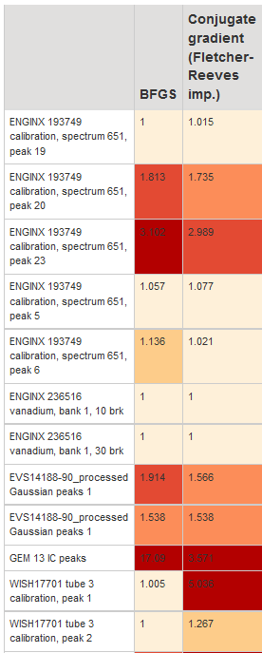

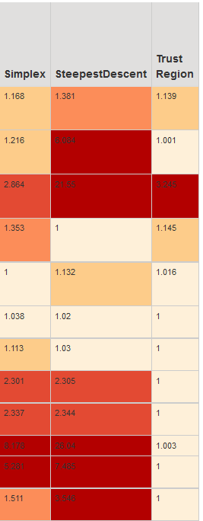

Slide 9
Local fitting - outputs
Fit benchmarking framework
First version. Communication:
In presentations to ISIS scientists
Nobugs 2016 copenhagen
In MCG presentations
EU SINE2020 workshop which generated SINE2020 news article
Provides a big improvement to how fitting is tested in Mantid and it has the potential to do this even better
Provided better documentation on Mantid fitting and its available minimizer
MCG minimizer
Preliminary results show that new MCG minimizer is better (on average) than other Mantid minimum (accuracy metric)
Made visible to user as a complementary option

Slide 10
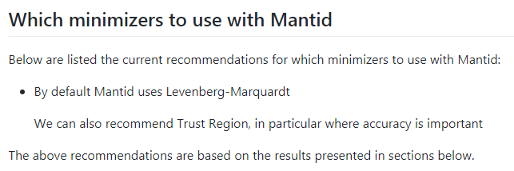
http://docs.mantidproject.org/nightly/concepts/FittingMinimizers.html

Slide 11
Remaining work: Realising the benefits
Mantid plumbing: Extend to show plots of the data; make it a package that can be run by a non-expert Python user; Extend it to be multiple dataset examples (all ~ 1 month)
Mantid plumbing: Adding ~50 more datasets (3 months)
MCG: ‘BAU’ new versions of MCG minimizers
Mantid plumbing: Bonus: extend to compare against e.g. scipy.optimize.minimize (2w). Easier after release 3.11

Slide 12
Issues for local fitting
Effort for Mantid plumbing
Federico Montesino and Thomas Perkins left Mantid
Currently some small percentage of Anthony Lim and my time. Anthony started in Mantid Dec. 17
Currently Mantid plumbing more the bottle-neck
Direct contribution to this from SCD also highly welcome (graduate rotation?)

Slide 13
Least-Squares Global fitting
ISIS Customer review meeting 30th Nov 2016 with 8 representatives from the different ISIS research groups
Outputs and conclusions from meeting:
All agreed they would like global optimisations tools on the tab and available from scripting
Although global optimisation GUI welcome, this was seen as less important compared to having tools available from scripting
Areas mentioned that would benefit from this: Excitation, spectroscopy (indirect), reflectometry, Muon, magnetic structure analysis on WISH data and future imaging processing/analysis tasks
Furthermore, excitation and indirect argued that ~100-300 parameter fits done used local optimisation would likely benefit from “global fitting” statistical tools, which could be used to “check” the validity of a solution found from local fitting

Slide 14
Issue Global fitting
There is a need
Harder problem compared to local fitting
As of now: On hold

Slide 15
One possible way forward with Global fitting
Joint position between ISIS/SCD, e.g. 3-year PhD student or PostDoc
This project requires both Mantid plumbing and research into global fitting options
A PhD student working on this for 3-4 years should be able to not only provide global fitting tools in Mantid but also a very good set of tools

